Slide 1
Image-and-Spatial Transformer Networks for Structure-Guided Image Registration
BY MATTHEW C.H. LEE, OZAN OKTAY, ANDREAS SCHUH, MICHIEL SCHAAP, BEN GLOCKER

Slide 2

Image Registration
Aligning Images for Better Analysis and Understanding
It aims to establish a transformation that best aligns the source image (object image) F with the target image (reference image) G
Overlaying and Comparing Images
Creating Panoramas and Orthomosaics
Enhancing Data Fusion
Source: https://en.wikipedia.org/wiki/Image_registration
Notes:
Overlaying and Comparing Images: Aligning images allows for seamless comparison of features, abnormalities, or changes between different perspectives or time points. This is particularly useful in medical imaging, where it facilitates the detection and monitoring of tumors, surgical planning, and tissue analysis.
Creating Panoramas and Orthomosaics: Image registration is essential for assembling multiple overlapping images into a seamless panorama or orthomosaic, providing a comprehensive view of a scene or area. This is commonly used in drone photography, satellite imagery, and architectural surveys.
Enhancing Data Fusion: By aligning images from different sources, image registration enables the fusion of data from different modalities, such as medical imaging modalities or remote sensing data, to create a more comprehensive understanding of a subject.
Wiki: One of the images is referred to as the moving or source and the others are referred to as the target, fixed or sensed images. Image registration involves spatially transforming the source/moving image(s) to align with the target image.

Slide 3
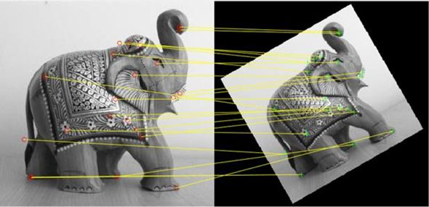
Image Registration Techniques
Techniques:
Intensity-Based Image Registration
Feature-Based Image Registration
Step by Step:
Feature Extraction
Feature Matching
Transformation Estimation
Transformation Application
Source: https://www.mathworks.com/discovery/image-registration.html
Notes:
Intensity-Based Image Registration: This method relies on the intensity values of corresponding points in the images to establish their alignment. It is a simple and efficient approach, but its effectiveness depends on the images having similar intensity distributions.
Feature-Based Image Registration: This method utilizes unique features or landmarks extracted from the images to establish correspondence. It is more accurate than intensity-based methods, especially when features are well-defined and prevalent in the images.
Wikipedia: Intensity-based methods compare intensity patterns in images via correlation metrics, while feature-based methods find correspondence between image features such as points, lines, and contours.
Feature Extraction: Extracting distinctive features or landmarks from each image. These features could be points, lines, edges, or more complex structures.
Feature Matching: Matching the extracted features between the two images, identifying corresponding points that align with each other. This often involves matching algorithms that measure the similarity or distance between features.
Transformation Estimation: Estimating the transformation that best aligns the matched features. This transformation can be linear, affine, or non-rigid, depending on the nature of the alignment required.
Transformation Application: Applying the estimated transformation to the source image, effectively warping it to fit the reference image based on the established alignment.

Slide 4
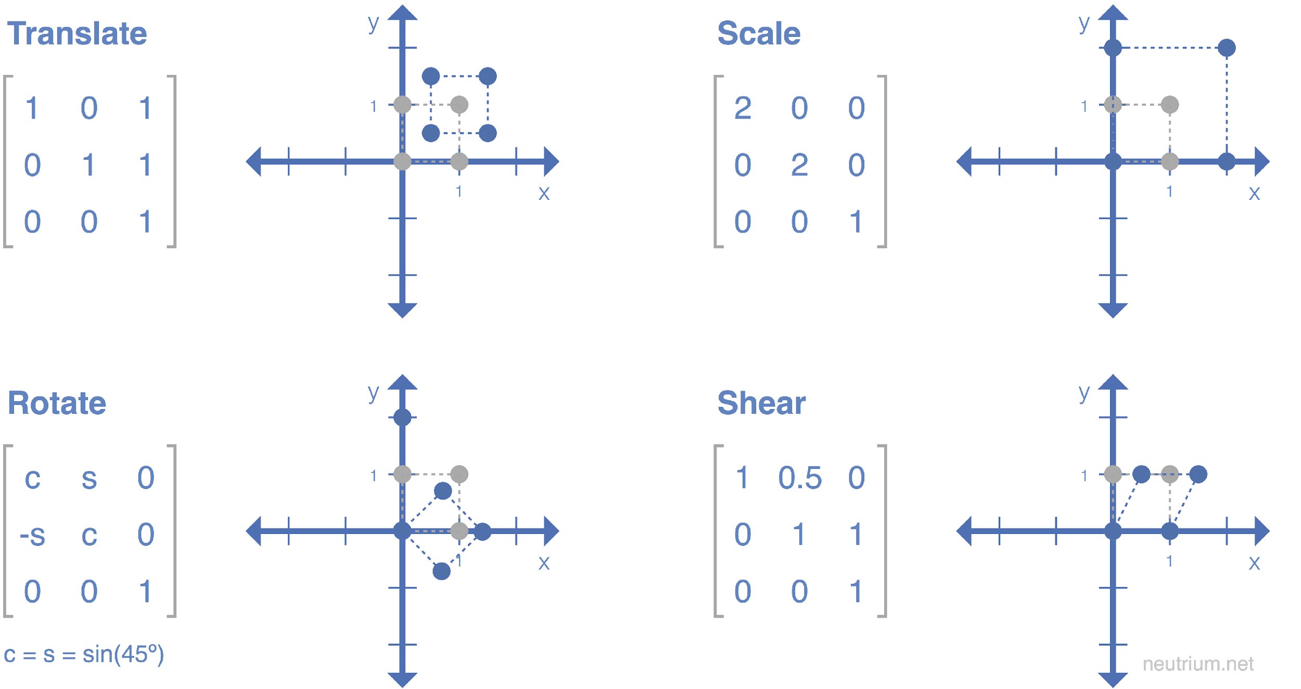
Affine Transformation
Source: https://neutrium.net/mathematics/basics-of-affine-transformation/

Slide 5
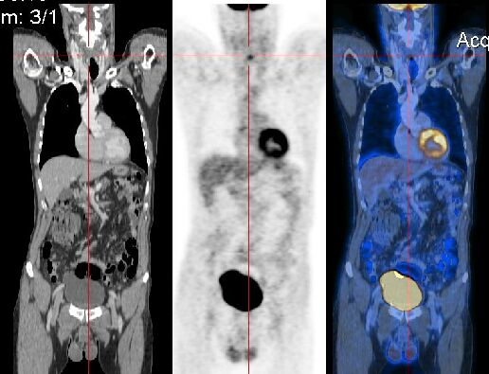
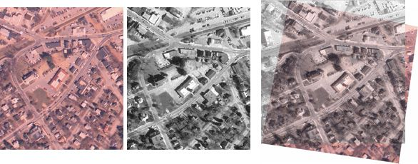
Applications of Image Registration
Medical Imaging
Geographical Analysis
Robotics
Art Restoration
Source: https://www.mathworks.com/discovery/image-registration.html; https://de.wikipedia.org/wiki/Bildregistrierung
Notes:
Medical Imaging: Registering medical images from different scans, such as CT, MRI, or ultrasound, allows for comparison of patient anatomy, tumor progression, or surgical outcomes.
Geographical Analysis: Registering satellite images, aerial photographs, or terrestrial data facilitates the creation of detailed maps, monitoring of changes in landscapes, and resource management.
Robotic Navigation: Registering sensor data from cameras, LiDAR, or other sensors enables robots to accurately map their surroundings, plan paths, and interact with the environment.
Art Restoration: Registering historical images and paintings with modern scans allows conservators to assess damage, identify restoration areas, and reconstruct missing fragments.

Slide 6
Spatial Transformers
Type of convolutional neural network (CNN)
Module that allows neural networks to learn how to perform spatial transformations on the input image.
They can learn to scale, rotate, translate, and deform the input image in order to align it with other images.

Slide 7
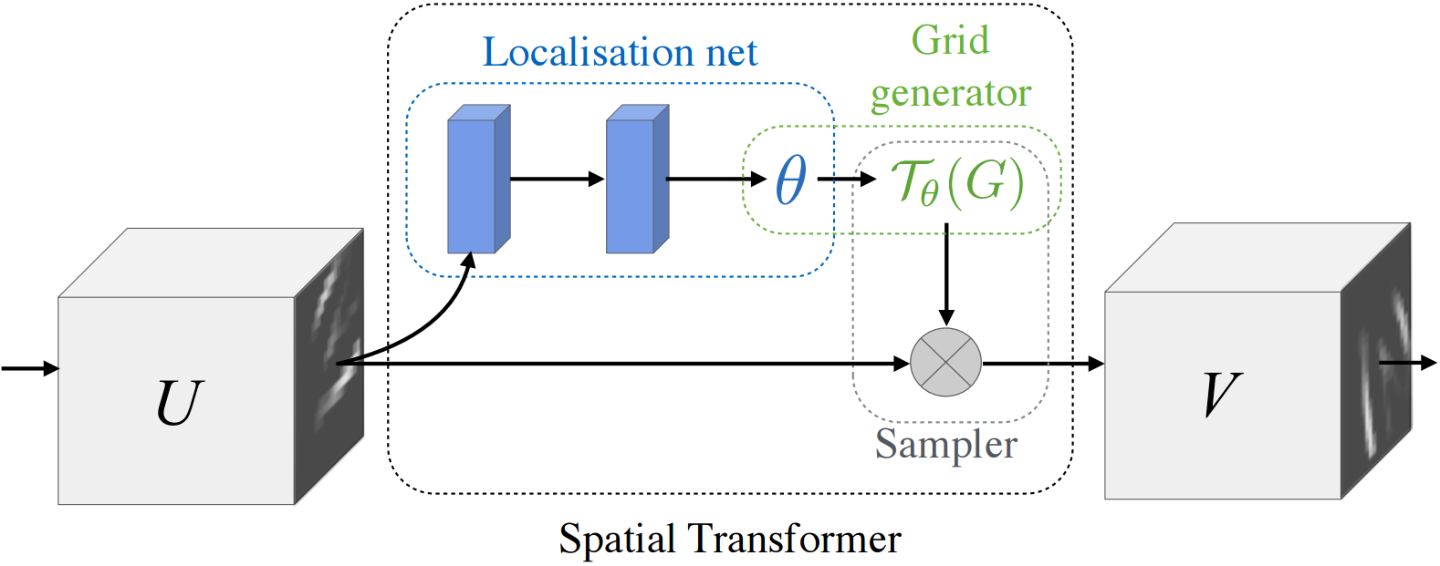
Spatial Transformers
Notes:
The localization network is a regular CNN which regresses the transformation parameters. The transformation is never learned explicitly from this dataset, instead the network learns automatically the spatial transformations that enhances the global accuracy.
The grid generator generates a grid of coordinates in the input image corresponding to each pixel from the output image.
The sampler uses the parameters of the transformation and applies it to the input image.

Slide 8
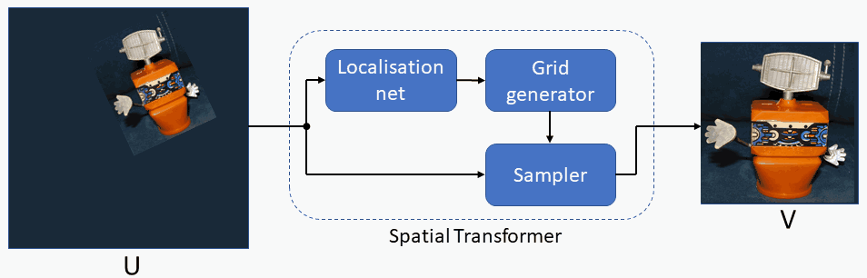
Spatial Transformers
Source: https://towardsdatascience.com/spatial-transformer-networks-b743c0d112be

Slide 9
Benefits of Spatial Transformers
End-to-end learning
Robustness to noise
Improved accuracy
Notes:
End-to-end learning: Spatial transformers can be learned end-to-end, which means that the network can learn the parameters of the transformation directly from the training data. This can be more efficient than traditional image registration techniques, which often require a separate registration step.
Robustness to noise: Spatial transformers can be more robust to noise than traditional image registration techniques. This is because they can learn to ignore irrelevant features in the input image.
Improved accuracy: Spatial transformers can often achieve higher accuracy than traditional image registration techniques, especially for complex transformations. This is because they can learn a more complex transformation model.

Slide 10
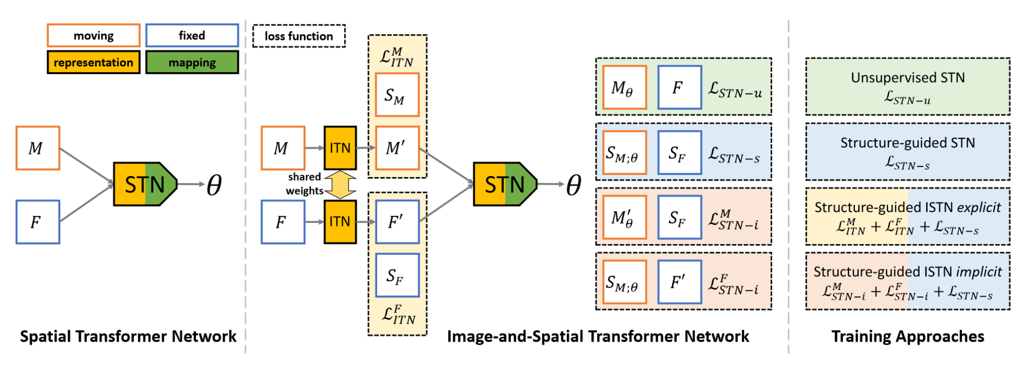
Image and Spatial Transformers
Notes:
Overview of image registration using Spatial Transformer Networks
(STNs), with the classical model shown on the left mapping an image pair M, F
directly to parameters θ of a spatial transformation (cf. [6, 7]). Our Image-and-
Spatial Transformer Networks (ISTNs) introduce a dedicated image transformer
network (ITN) to learn to produce image representations M ′, F ′ optimised for
the downstream registration task, as well as predicting θ. This gives raise to mul-
tiple ways of training ISTNs by combining different loss functions (see Sec 2.2

Slide 11
Image-and-Spatial Transformer Networks (ISTN)
To make best use of the key ability of neural networks to learn representations, they introduce Image-and-Spatial Transformer Networks (ISTNs) where a dedicated Image Transformer Network (ITN) is added to the head of a Spatial Transformer Network (STN) aiming to extract and retain information about SoIs, for which annotations are only required during training.
STN predicts the parameters of the spatial transformation
ITN produces a new image representation which is learned in an end-to-end fashion and optimised for the downstream registration task. Registration focuses on aligning the white box ignoring Structures-of-Interest (SoI), i.e., the vessels.

Slide 12
Structure of an Spatial Transformer Networks (STN)
There are two main components:
a feature extraction part learning a new representation of the input using convolutional layers
a part that maps these representations to transformation parameters
New image representations means: extracts the same structures of interest (soi) in both images.
The representation that STNs may learn, however, is not exposed and remains hidden during inference. To solve this problem, they redesign the basic building block of the transformer module of neural network based image registration by introducing a dedicated Image Transformer Network.

Slide 13
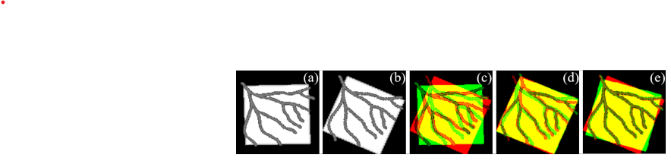
Image Transformer Networks (ITN)
Image registration is the process of calculating spatial transforms Tθ which align a set of images to a common observational frame of reference, often one of the images in the set.
The role of the ITN is to expose explicitly a learned image representation that is optimal for the registration task solved by the STN. A shared ITN learns to generate outputs M’ and F’, which are fed into a regular STN, where M is the moving source image undergoing spatial transformation and F is the fixed target image. Thanks to these representations a test-specific, iterative refinement over the transformation parameters can be employed, which yields highly accurate registration.
Image registration (image alignment)

Slide 14
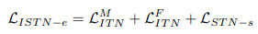
Explicit and Implicit Training of ISTNs
Explicit training of ISTNs
Different loss functions can be considered for training ISTNs. They use loss functions for an optimisation problem seeking optimal transformation parameters θ that minimise a dissimilarity measure (or cost function) ,where M is the moving source image undergoing spatial transformation and F is the fixed target image.
They propose a loss function for the explicit ISTN training, when auxiliary information about SoIs is available. It is defined as:

Slide 15
Explicit Training of ISTNs
This loss function combines the supervised STN with an ITN loss. ‘Supervised’ refers to the fact that such SoIs need annotations on the training data.
While the explicit loss has the desired effect of producing representations capturing the SoI information, the ITN and STN losses are somewhat decoupled where the ITN loss plays the role of deep supervision.
While the STN predicts the parameters of the spatial transformation, the ITN produces a new image representation which is learned in an end-to-end fashion and optimised for the downstream registration task.

Slide 16
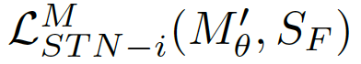
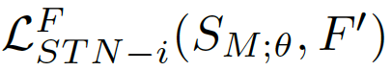
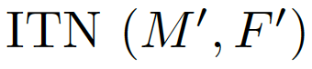
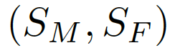
Implicit Training of ISTNs
- and intertwine the outputs of the the SoI encodings and the estimated transformation parameters θ from STN
- Supervised STN loss provides a fully end-to-end training of image representations that are optimised for the downstream registration task.

Slide 17
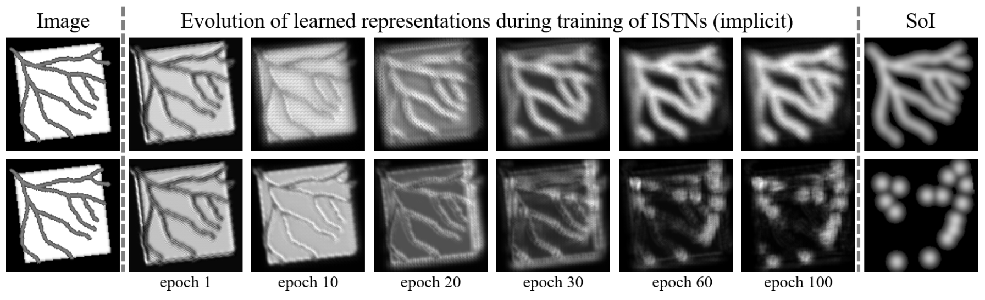
Evolution of ITN representations over the course of training
- Top row - segmentations
- Bottom row - landmark annotations (distance maps)
- The learned image representation allows accurate structure-guided registration with test-specific refinement at test time.

Slide 18
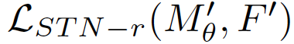
Test-specific Iterative Refinement
- The key of ISTNs - enable structure-guided, test-specific refinement based on the learned representations M’ and F’
- Any registration technique can be used for refinement by using the inferred images M’ and F’ as inputs
- We can also directly leverage the STN module itself to perform the refinement at inference time by iteratively updating the STN weights (ITN weights fixed) through minimization of a refinement loss,
- Since the representations M’ and F’ are generated by the trained ITN, no annotations are required for the test images to perform the iterative refinement

Slide 19
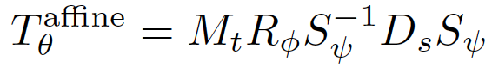
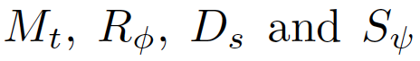
Transformation Models
- This ISTN architecture allows the integration of various linear and non-linear transformation models
- We employ a typical parameterisation for affine transformations decomposed into
where are the translation, rotation, scaling and shearing matrices
- This decomposition allows us to set intuitive bounds on the individual transformation parameters by using appropriately scaled tanh functions.
-For non-linear registration we employ a standard B-spline parameterisation using a regular grid of control points. Transformation parameters θ then correspond to control point displacements.

Slide 20
Experimental Setup
Pairwise registration of brain MRI.
420 individual subjects from the UK Biobank Imaging Study.
100 random pairs of moving and fixed images for training.
10 pairs for validation, and 100 pairs for testing.

Slide 21
Experimental Setup
Images are skullstripped and intensity normalized.
Binarised segmentation label maps are used as the SoI information.
calculating Dice scores and average surface distances (ASDs).
The Dice Score is a measure of the spatial overlap between the predicted and true segmentation masks.
Dice=2×∣A∩B∣​÷∣A∣+∣B∣
The Dice Score ranges from 0 to 1, with 0 indicating no overlap and 1 indicating perfect overlap

Slide 22
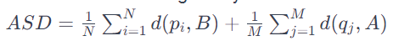
Experimental Setup
ASD measures the average distance between the points on the predicted surface and the points on the true surface.
compare the explicit and implicit variants (ISTN-e and ISTN-i) with unsupervised and supervised models (STN-u and STN-s)

Slide 23
Experimental Setup
affine and non-linear B-spline transformation models.
30 mm control point spacing for B-splines.
ISTN-e/i outperform STN-u/s for the one-pass predictions.
ISTNs achieve overall highest Dice scores and lowest ASDs.

Slide 24
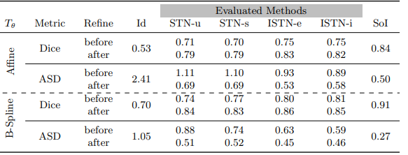
Experimental Setup

Slide 25
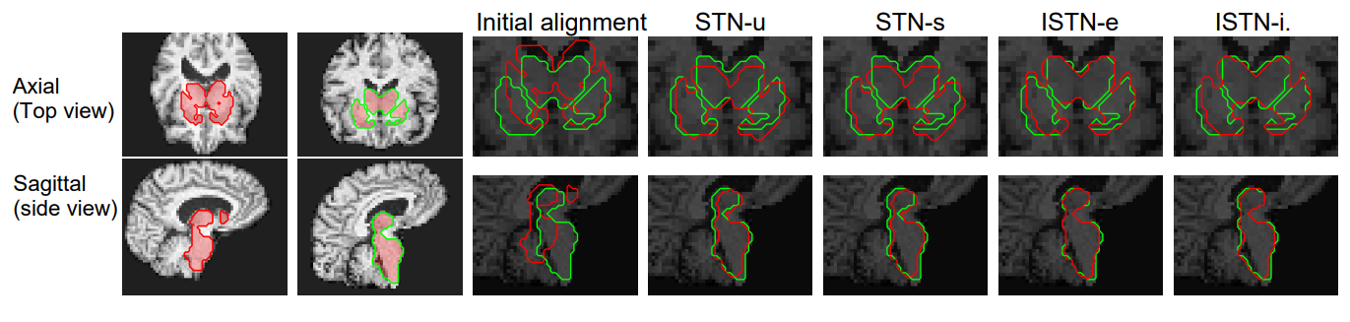
Visual results for affine registration with SoI overlaid in red (moving), and green (fixed).
On the left: the input images before registration. Close-ups from left to right: initial alignment, STN-u, STN-s, ISTN-e, ISTN-i.

Slide 26
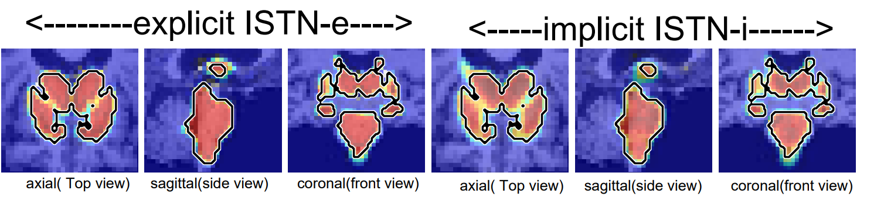
Overlay of the learned representations of sub-cortical structures as heatmaps on top of a test input.
The axial, sagittal and coronal slices on the left correspond to the ITN output of an explicit ISTN-e, the left shows the output for an implicit ISTN-I.
Black contours show the ground truth segmentations.

Slide 27
THE FINAL EXPERIMENT
Repeated the whole experiment with large dataset of 1000 pairs for training purpose.
EXPETIMENT RESULTS:
Without any fine tuning or without further adjustments the predictions improved as compared to the lower size data set of 100 pairs.
Iterative refinement produces nearly identical outcomes for STN-u/s compared to previous results when trained with 100 pairs, and exhibits slight enhancements for ISTNs.
ISTNs trained using only 100 pairs achieve significantly higher accuracy compared to STN-u and STN-s trained with 1,000 pairs.
This highlights excellent data efficiency and emphasizes the advantages of iterative, test-specific refinement for image registration.
--:Dicescores with different methods on different transformation (with previous results):--
Transfomation | STN-u | STN-s | ISTN-e | ISTN-i
Affine | 0.75(0.71) | 0.77(0.70) | 0.80(0.75) | 0.80(0.75)
B-Spline(non- linear) | 0.79(0.74) | 0.83(0.77) | 0.86(0.80) | 0.86(0.81)

Slide 28
Conclusion
ISTNs performs well in the image registation the STNs in all scenarios according to the test result.
Usage of Structures-of-Interest (Sol) can improve the accuracy of image registration.
Implicitly learned representations may be beneficial to prevent overfitting in cases where SoI information contains noise or corruption.

Slide 29

THANK YOU !
Research Paper URL

